Slide 1
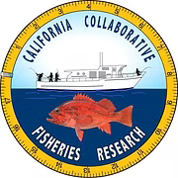


FishSense Mobile
A Mobile Device App for On-Deck Fisheries Management Operations
Christopher L. Crutchfield, Nykolas Rekasius, Anu Jajodia, Theodore Darci-Maher, Sijan Shrestha, Aayushka Budhathoki, Annabelle Chen, Brendon Mwamba, Zach Merson, Shawn Doyle, Grace Turner, Jakob Tallman, Cole Wilson, Jack Elstner, Brice X. Semmens, Curt Schurgers, Ryan Kastner
Notes:
Talk to you about an mobile device app for On-Deck fisheries management.

Slide 2
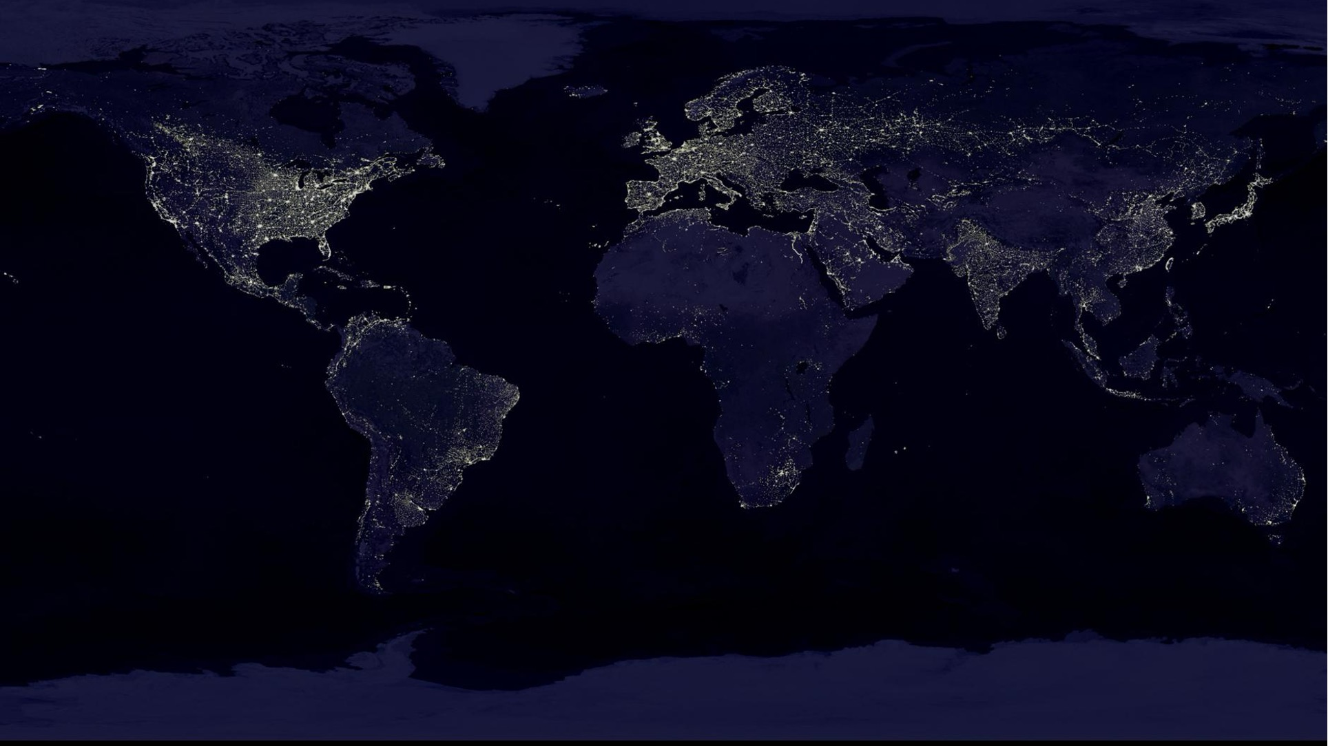
Challenges and Opportunities
3 billion people rely on seafood as a source of protein
Challenge: 1/3 of global fish stocks are over exploited: biodiversity losses & fisheries collapses
Opportunity: Managing fisheries for long-term sustainability requires more information to preventing overfishing
Notes:
Overfishing = biodiversity loss
Fisheries are undermonitored
Need a few key points of information

Slide 3

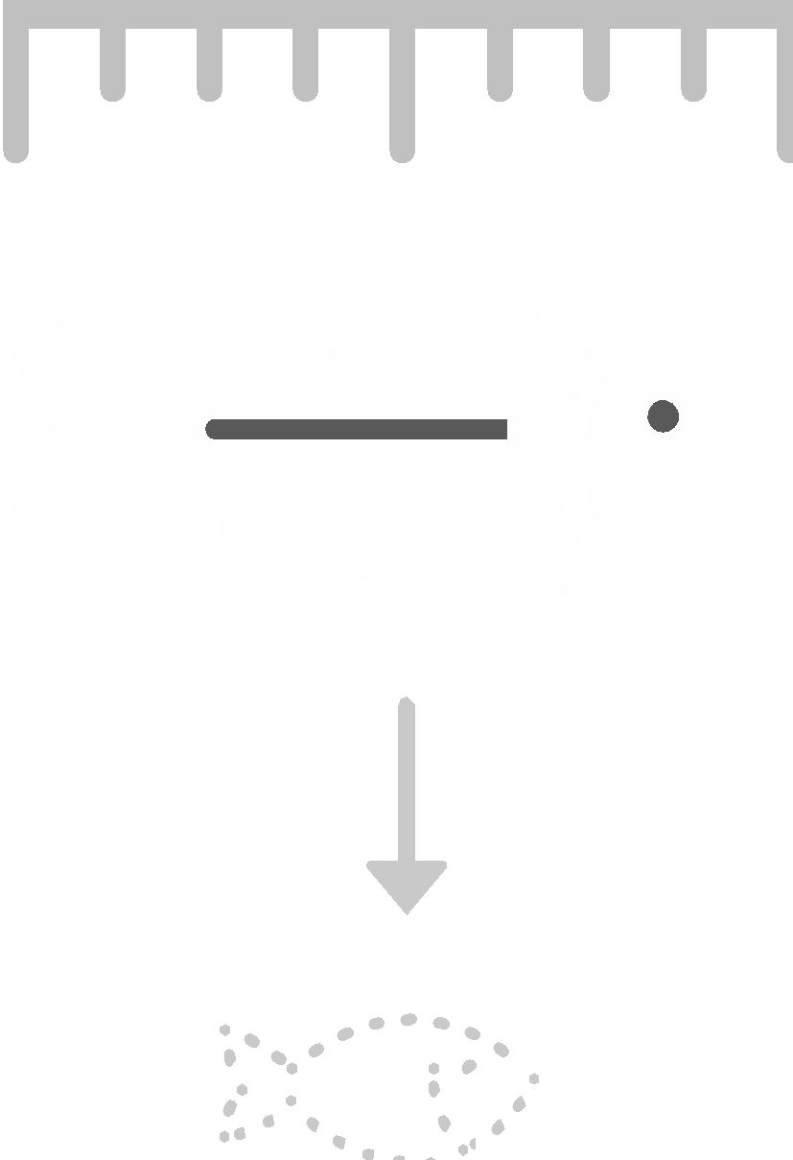



Fisheries: Status, Size, and Sustainability
Globally 99% of Fisheries are Unassessed
Data Collection is Expensive and Difficult
Notes:
Age of fish is important
Can't ask a fish its age
Larger fish = older fish = more babies
Babies are important for sustainable fishing
Length is our first key point of information

Slide 4
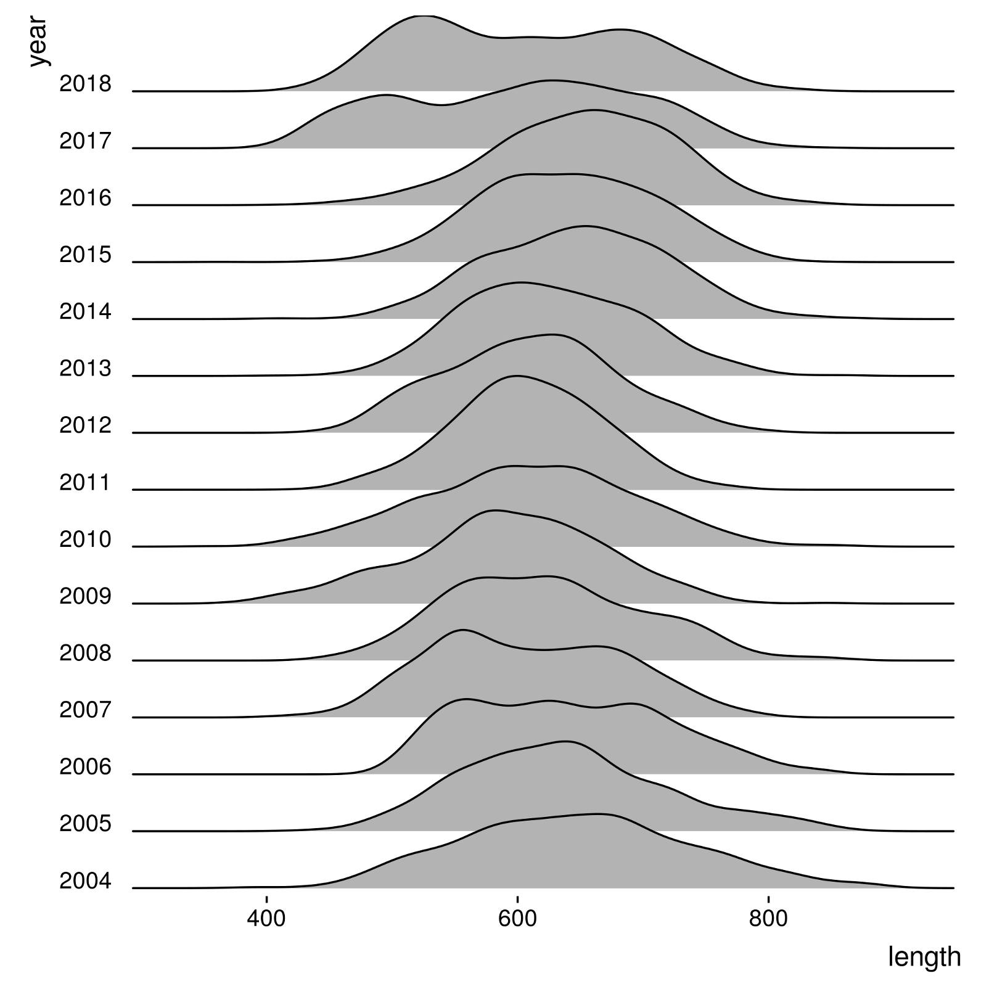
What Size are They?
How Many are There?
Nassau Grouper Size Frequencies
https://doi.org/10.1093/icesjms/fsaa221
Notes:
Data collected by Stock et al
Data of Groupers
Large population = healthier population
Significant lag in policy to bounce back

Slide 5
How do we collect this information?

Slide 6
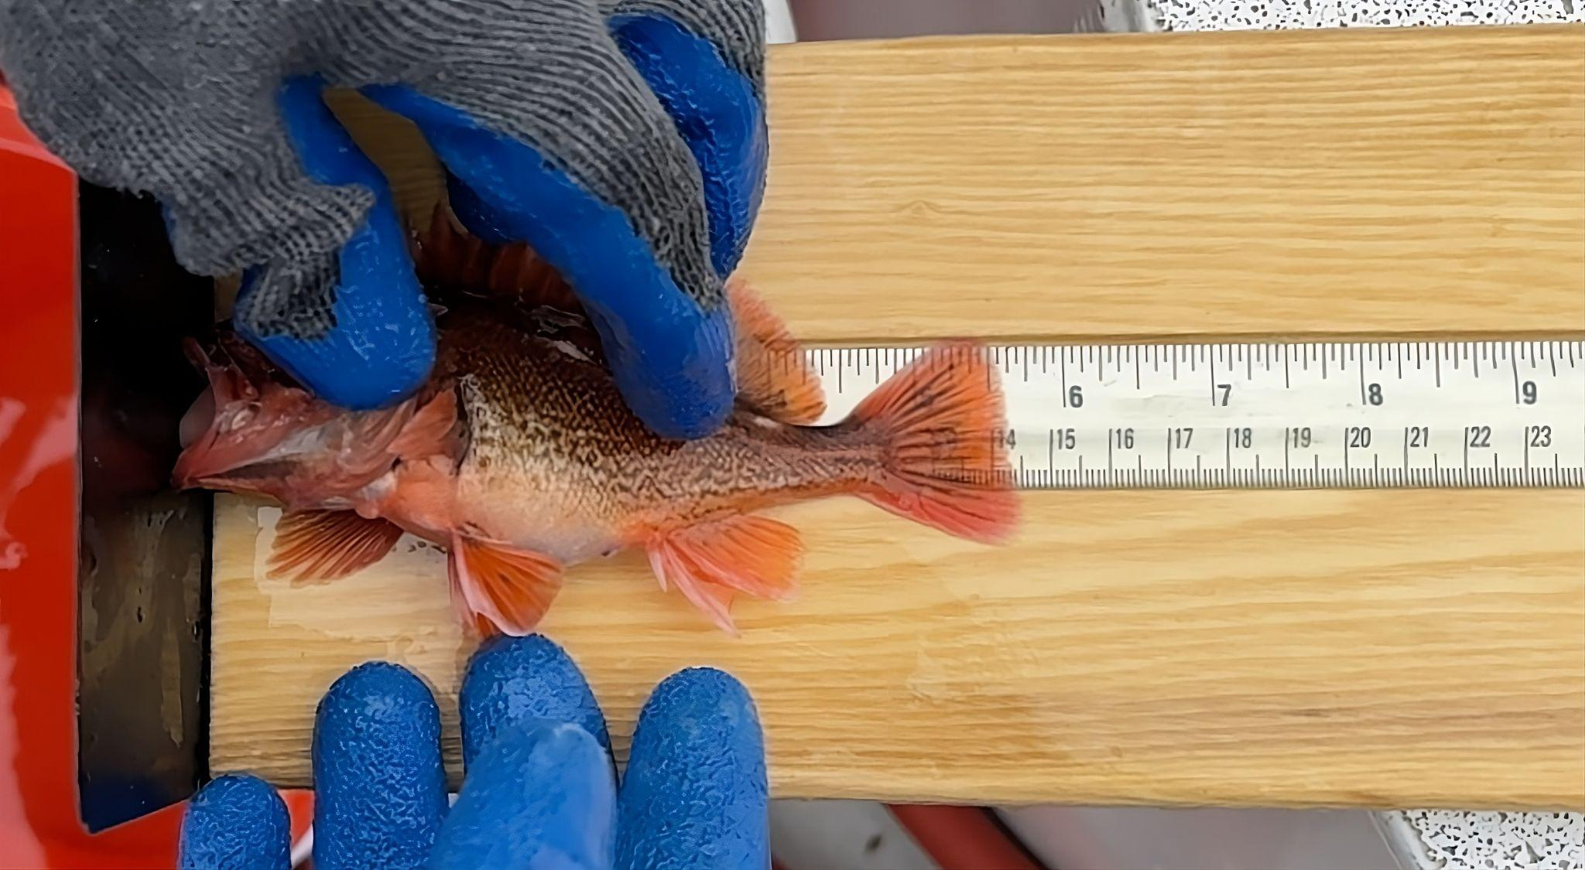
Notes:
Length = Put the fish on a ruler
Hard to measure
Can be inaccurate

Slide 7
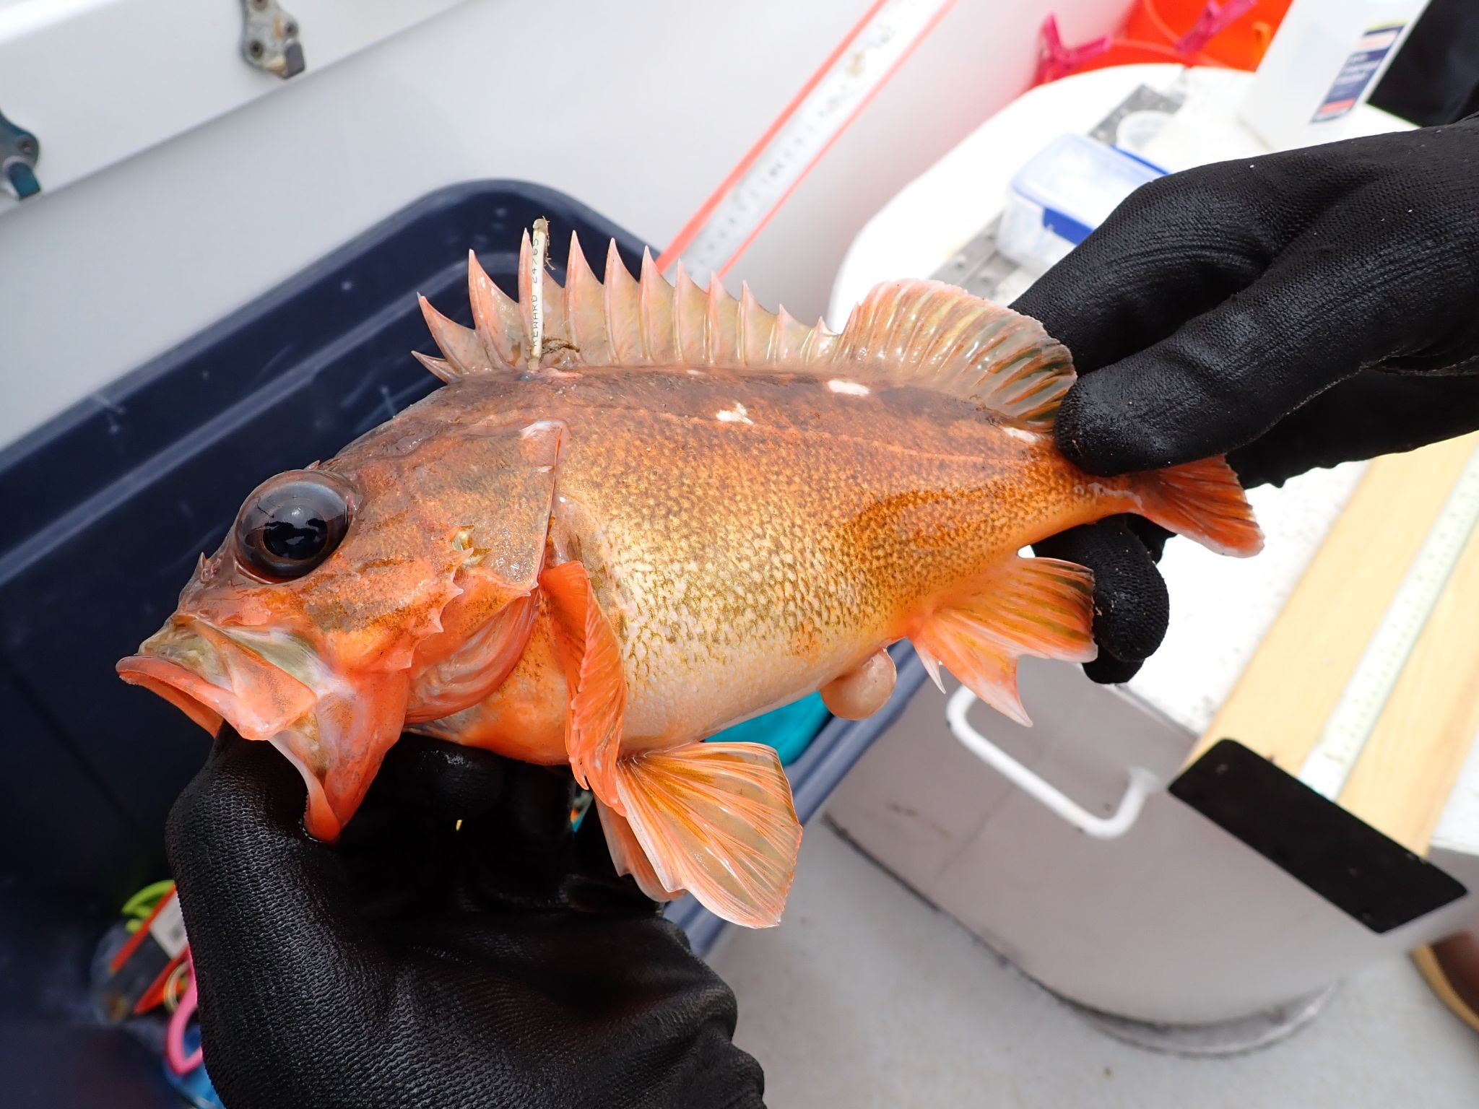
Notes:
Count = Count all the fish?
Can’t count all fish, use tags instead
Can model how many fish by knowing total number of fish tagged vs fish recaptured vs fish caught

Slide 8
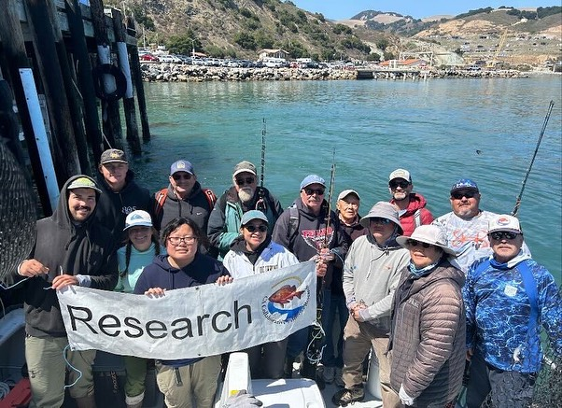
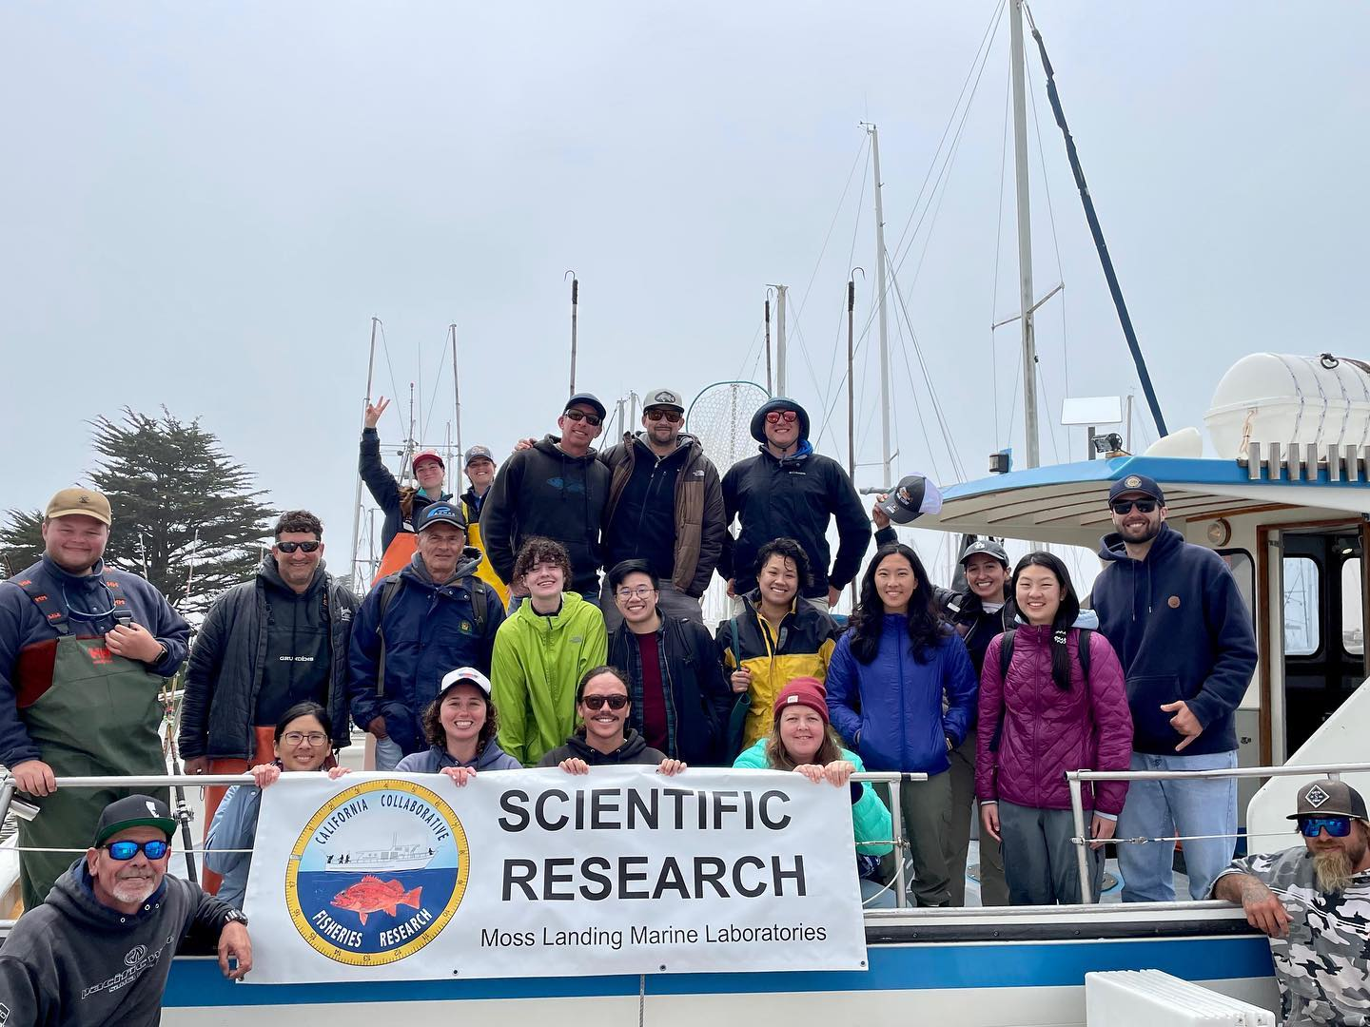
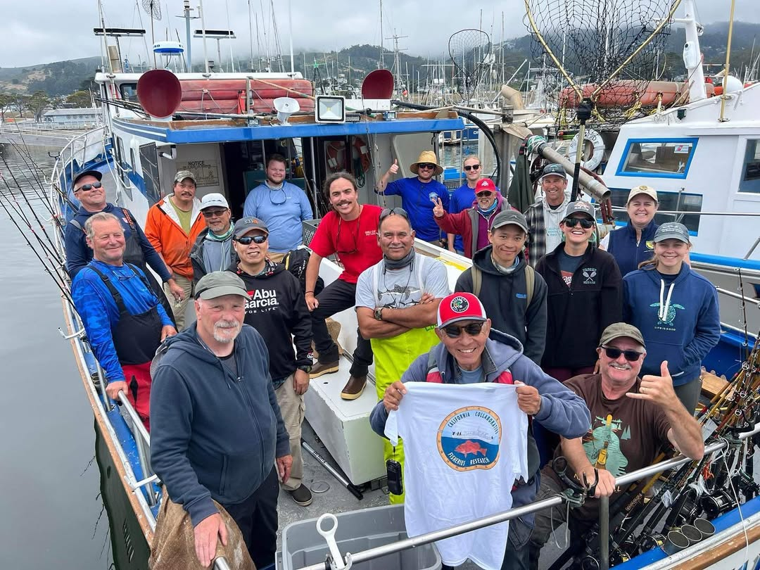
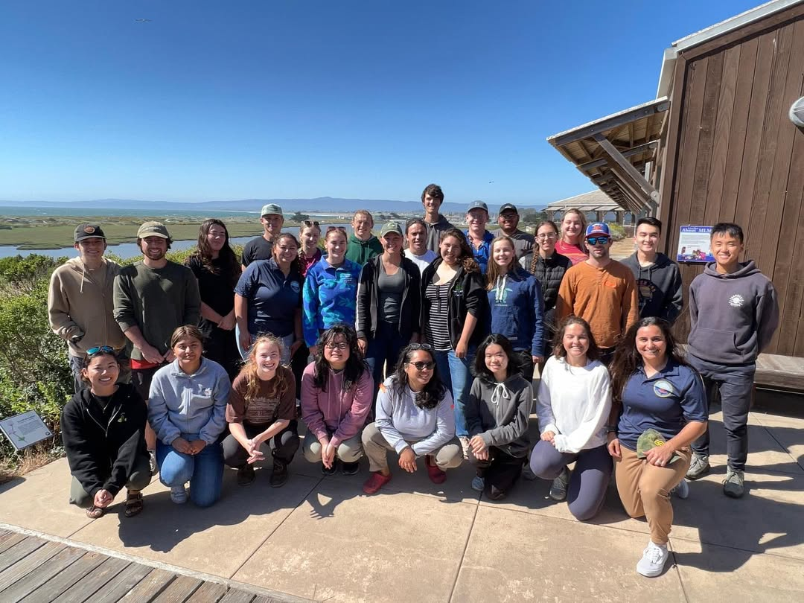
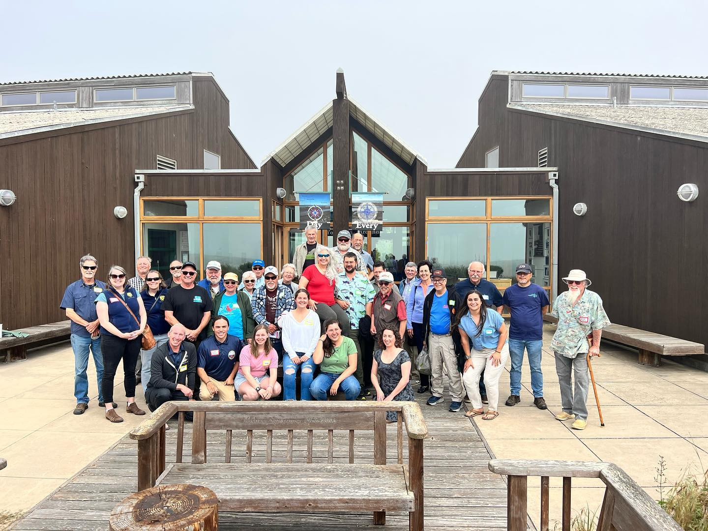
Notes:
California has CCFRP
California Collaborative Fisheries Research Program
This is expensive
Takes lots of people
And I mean lots of people

Slide 9
World Coastline
~ 311,000 km
United States Coastline:
~20,000 km
State of California Coastline:
~1,350 km
Notes:
California Coast - 840 miles / 1352 km
Total US Coastline - 12,383 miles / 19929 km
Total World Coastline - 193,000 miles / 310,600
CA spent 500k in 2022
Scaled up, 7M for all of US
116M for world wide

Slide 10
Can we increase data with technology?
Notes:
Can we use

Slide 11
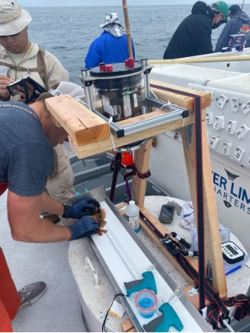
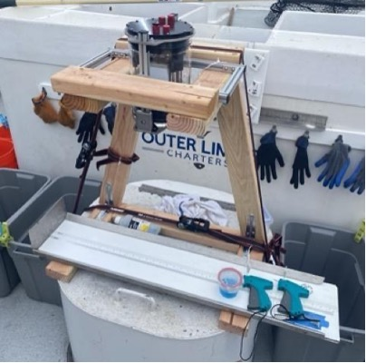
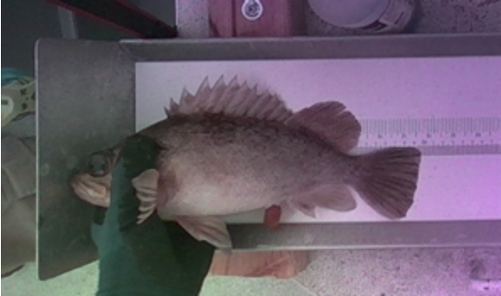

Slide 13
How do we scale?
Citizen Science!
Notes:
Intead of focusing on improving CCFRP, can we use citizen science?
Citizen science is the process of democratizing the collection of data

Slide 14
System Requirements
System is commercially available
Depth Sensor
High-resolution RGB Camera
Onboard compute capabilities
Notes:
Goal: Use recreational anglers
Provide them with a depth sensor to measure
Camera so that we can do species identification and virtual tagging
Compute to run AI models
Commercially available so that end users can buy it
BONUS: What if it’s a device they already have?

Slide 15
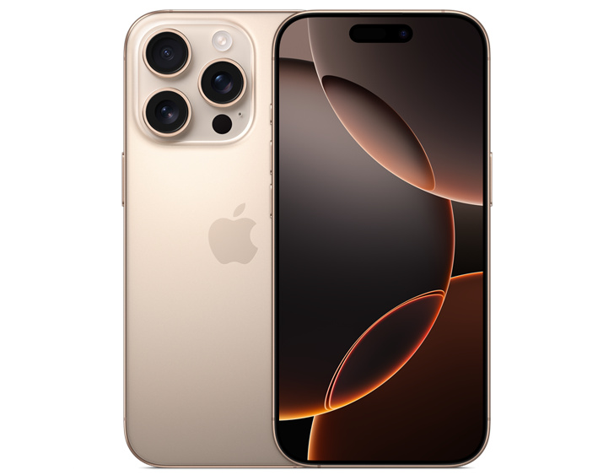
LiDAR
Credit: apple.com
Notes:
iPhones are commercially available
Many people already have them
Advance Slide: LiDAR provides us with a depth sensor
Camera on iPhone is good
We can leverage metal for ondevice compute
All sounds good, let’s test it!

Slide 16
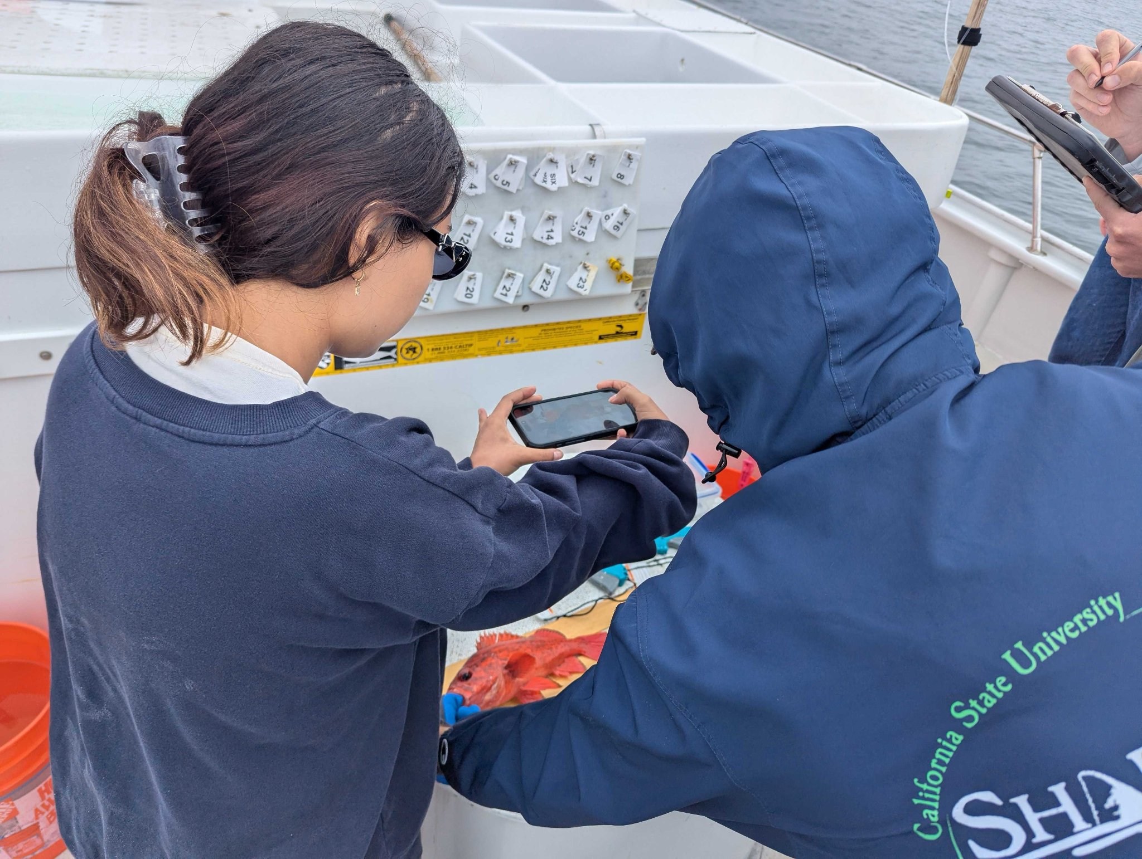
Notes:
So we did.
This is us using our App on fish during a CCFRP cruise.
It really is just point and shoot!
Let’s see how easy in a demo

Slide 17
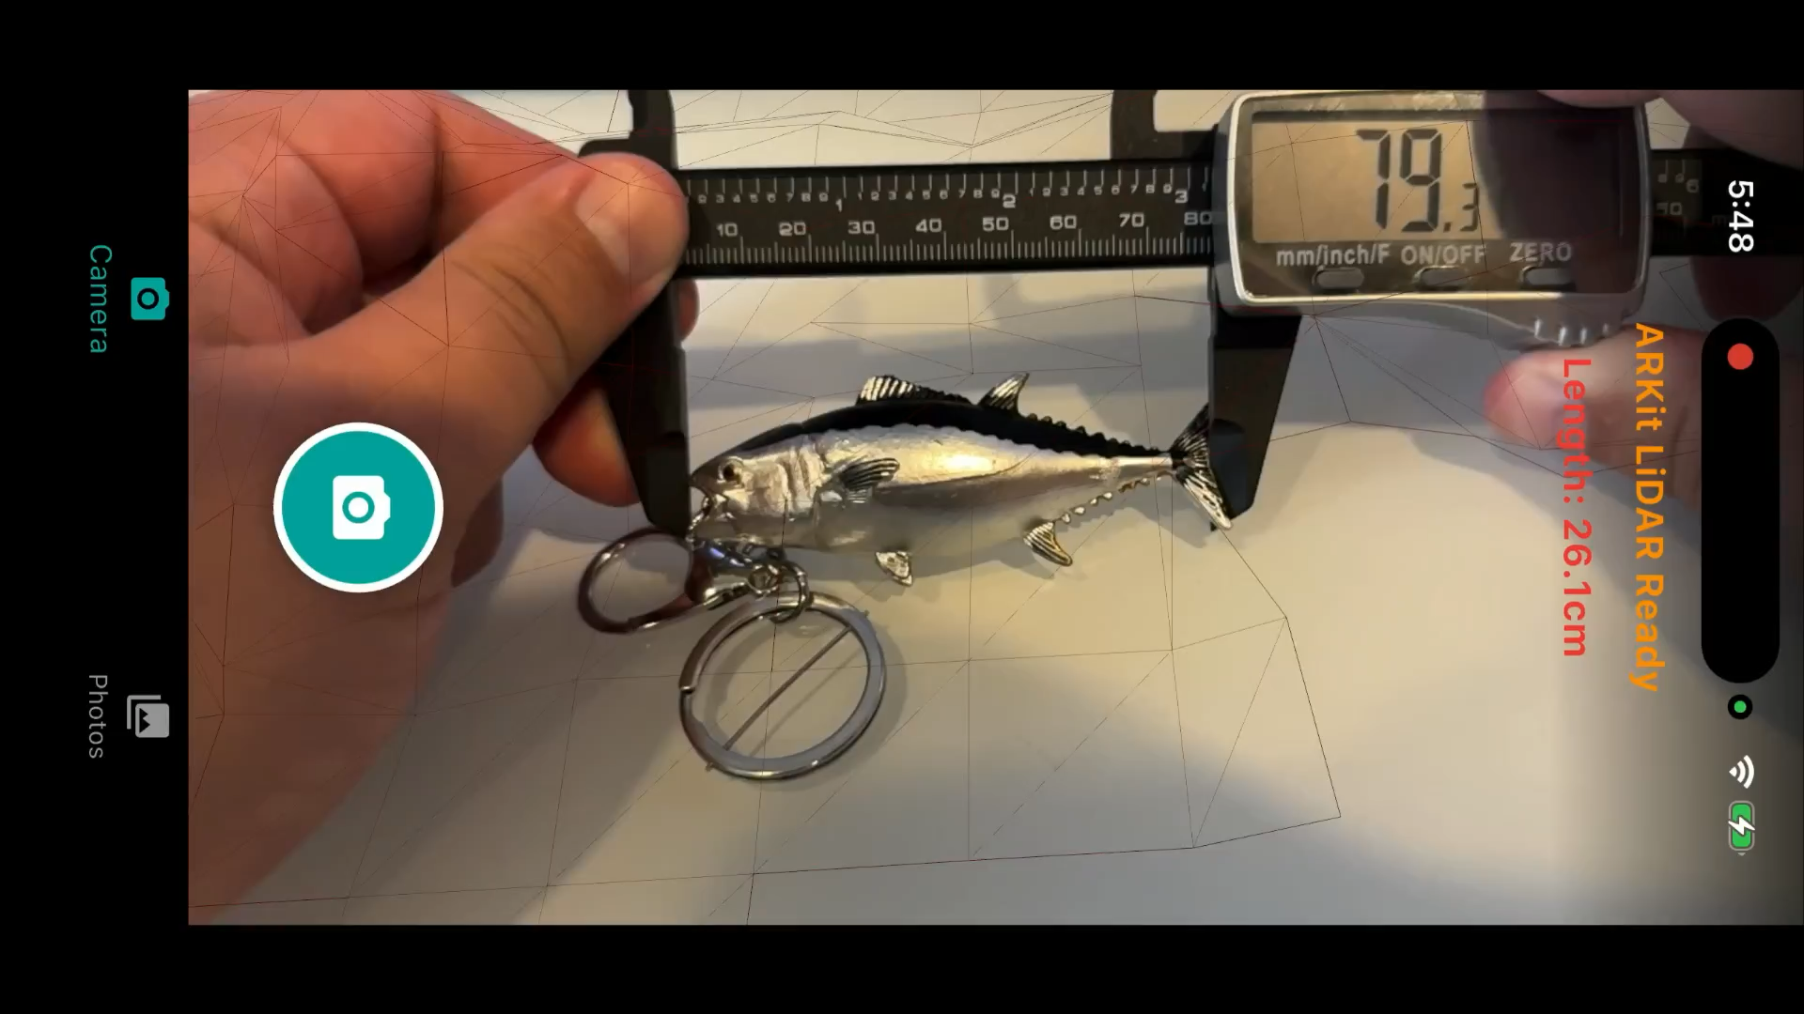
Notes:
This is a screen recording, I’m happy to live demo after the talk to anyone who is interested
We start with a measurement of the fish for reference.
This is only for the purpose of the demo
The calipers are not used for the measurement
This runs an AI model and produces the fork length
Fork length is displayed on screen
And in the photo gallery

Slide 18
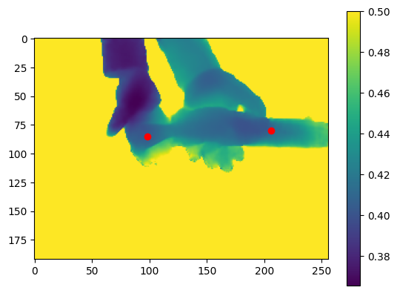
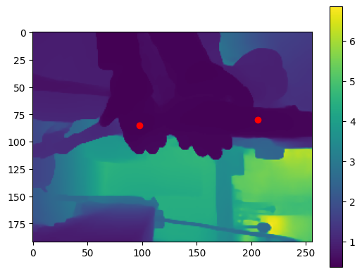
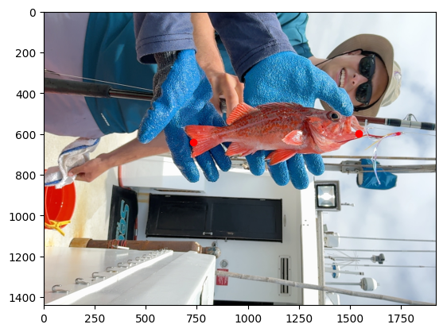
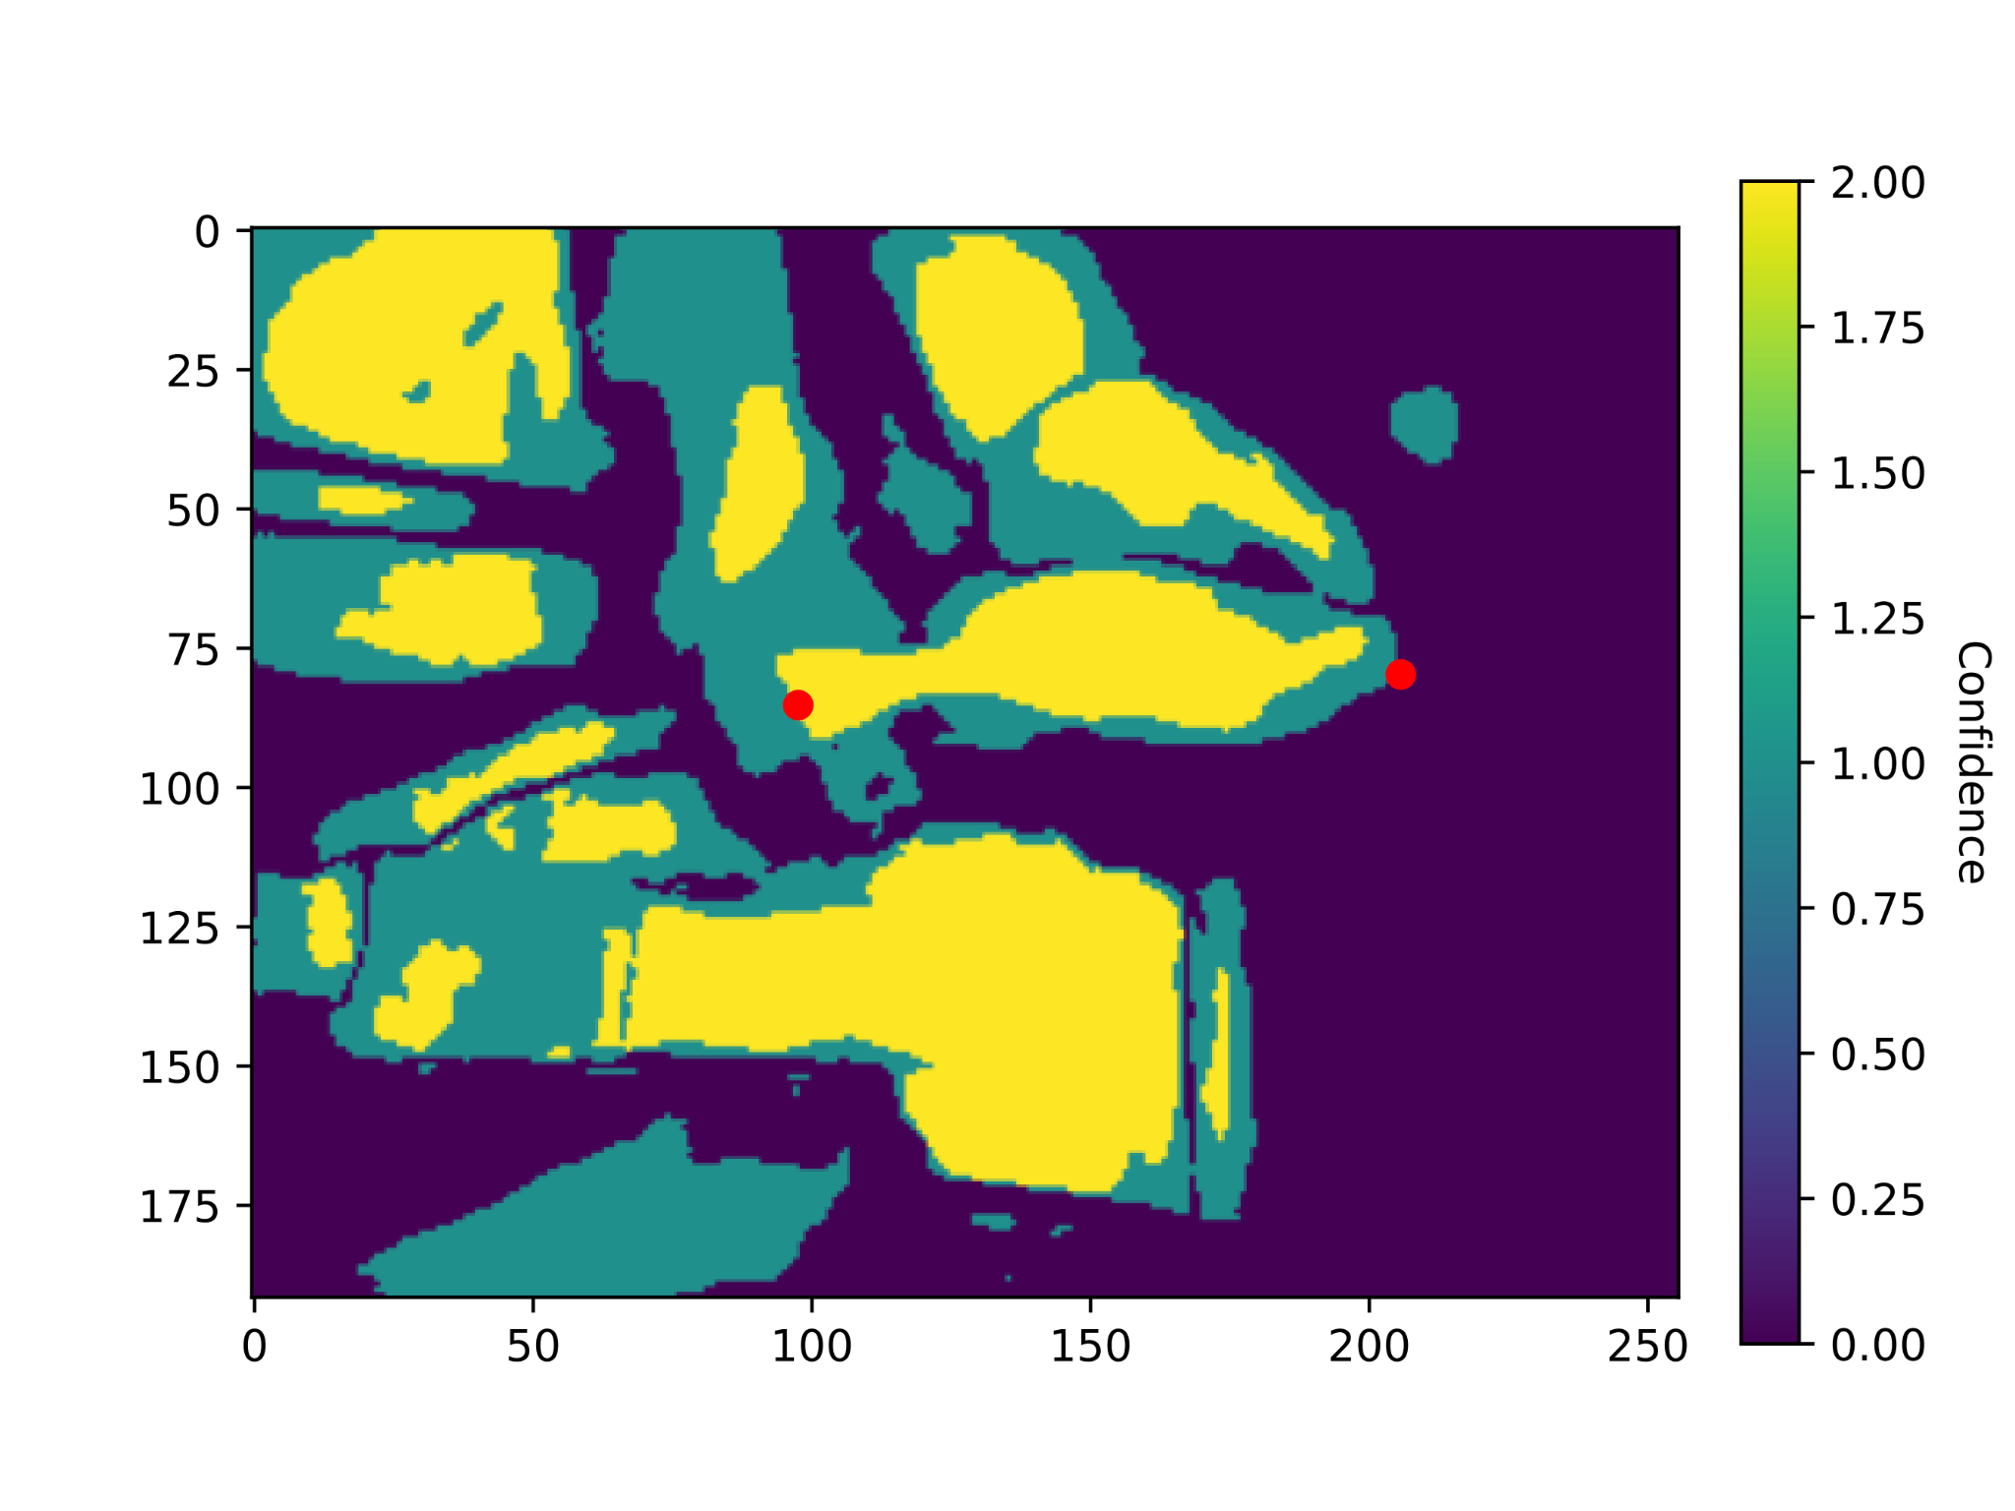
What does the App See?
Meters
High
Med
Low
(a) RGB Image
(b) Depth Map
(c) Confidence
Notes:
We get three different representations of the scene
“A” is from the camera
“B” is directly from the LiDAR and represents the metric depth
Advance Slide: I understand it can be a little hard to see, so I have clipped it to half a meter
Clipping is for demonstration purposes only and not used by the app
“C” represents the confidence of every LiDAR measurement
Think “how accurate is the LiDAR at this pixel?”

Slide 19
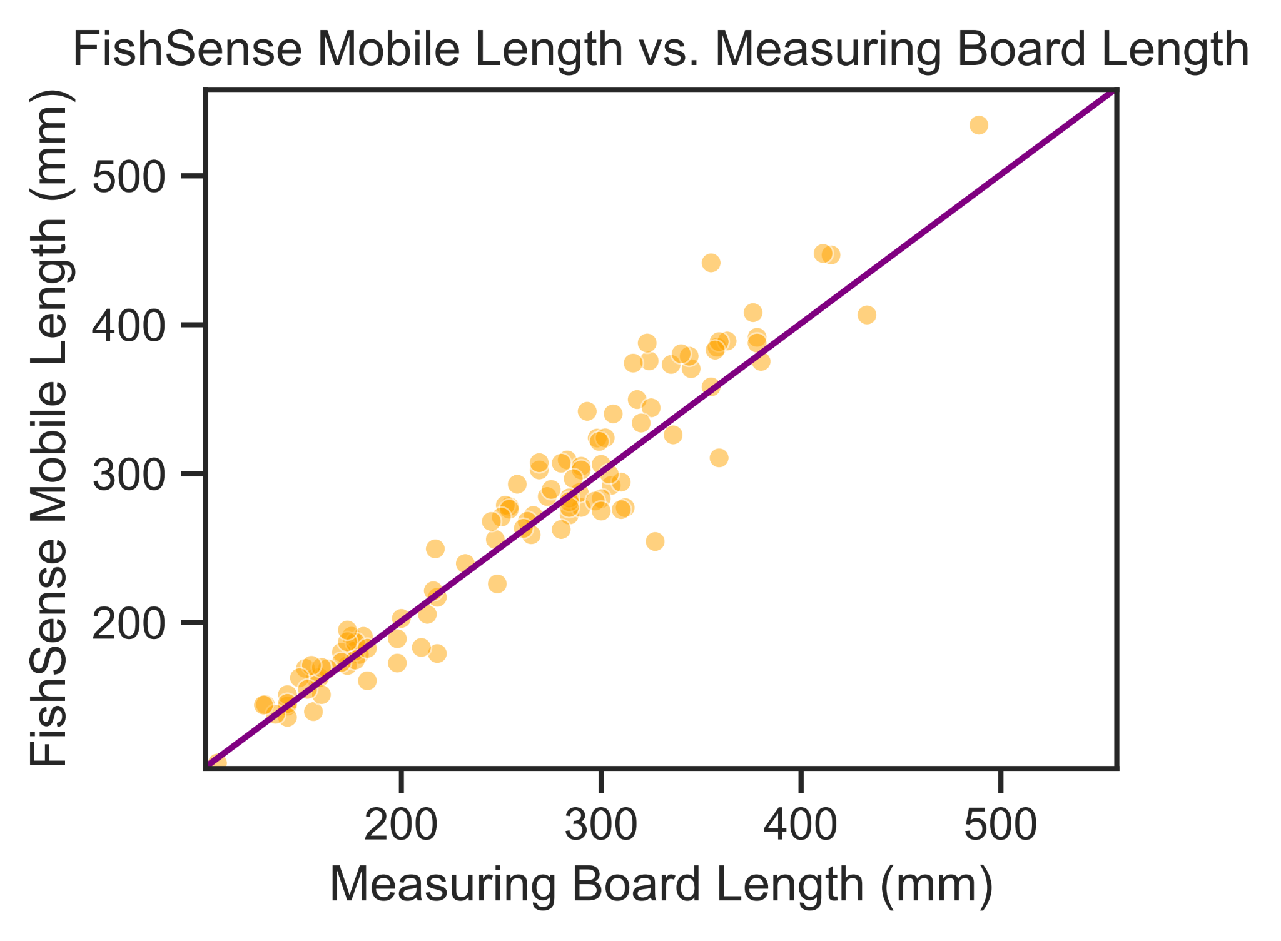
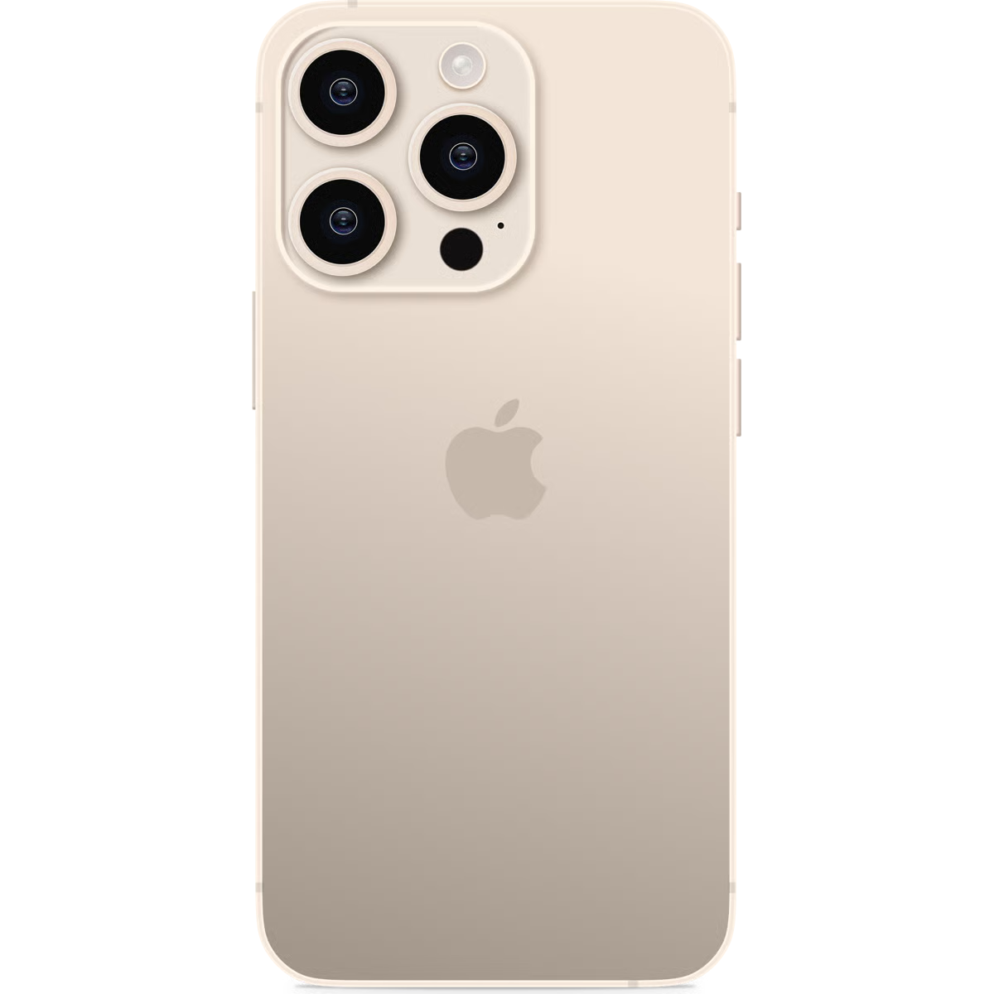
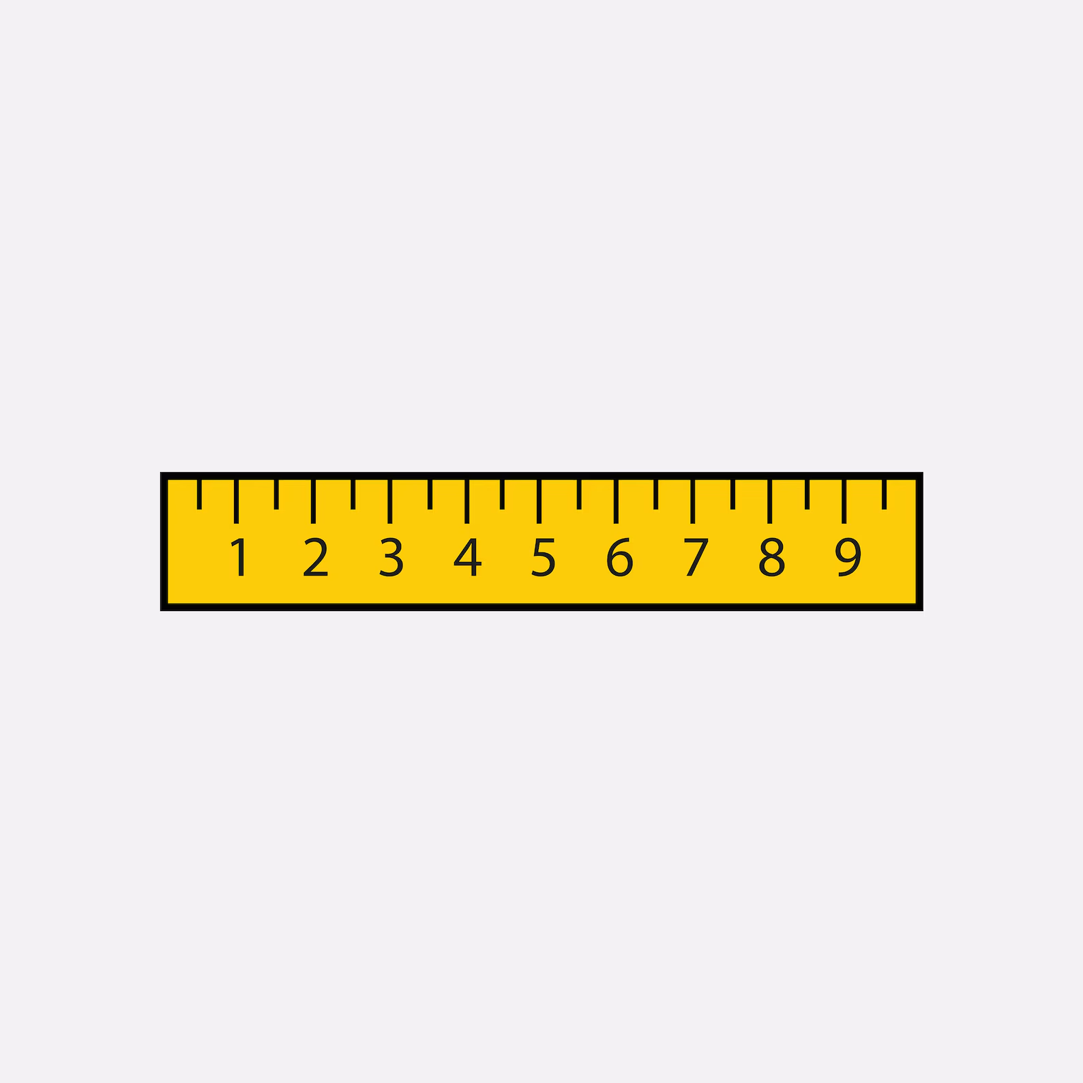
R² = 0.994
Notes:
Comparison of our app against length board while on the CCFRP boat trip
X axis is once again the length board
Y axis is the measurement from our app
R^2 value of 0.994, indicating high correlation between fishsense mobile and length board
This indicates that fishsense mobile can be used as a replacement for length board measurements

Slide 20

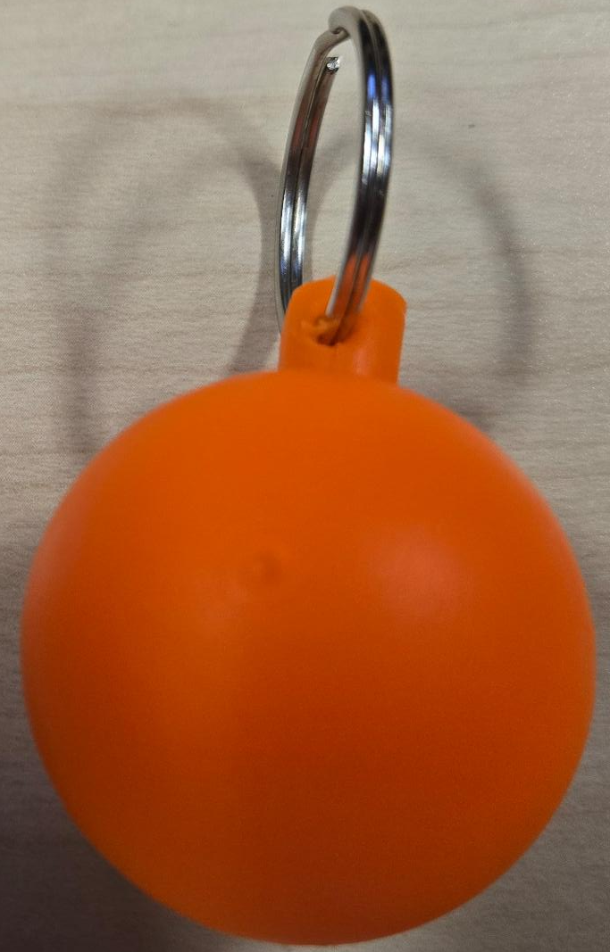
Notes:
Fishtechy appears to match most of our requirements
We first evaluated Fishtechy as an option
Uses *this* proof ball for measuring

Slide 21
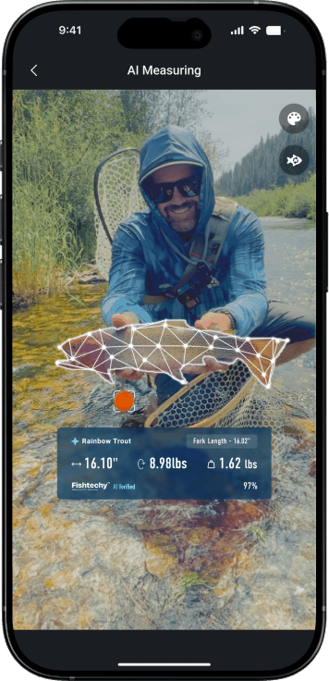
Notes:
Didn’t fit our needs
Proof ball got lost in hectic CCFRP trips
“Where is the proof ball”
Proof ball needs to be in the frame
Fishtechy uses cloud to do processing, issues out in the ocean

Slide 22
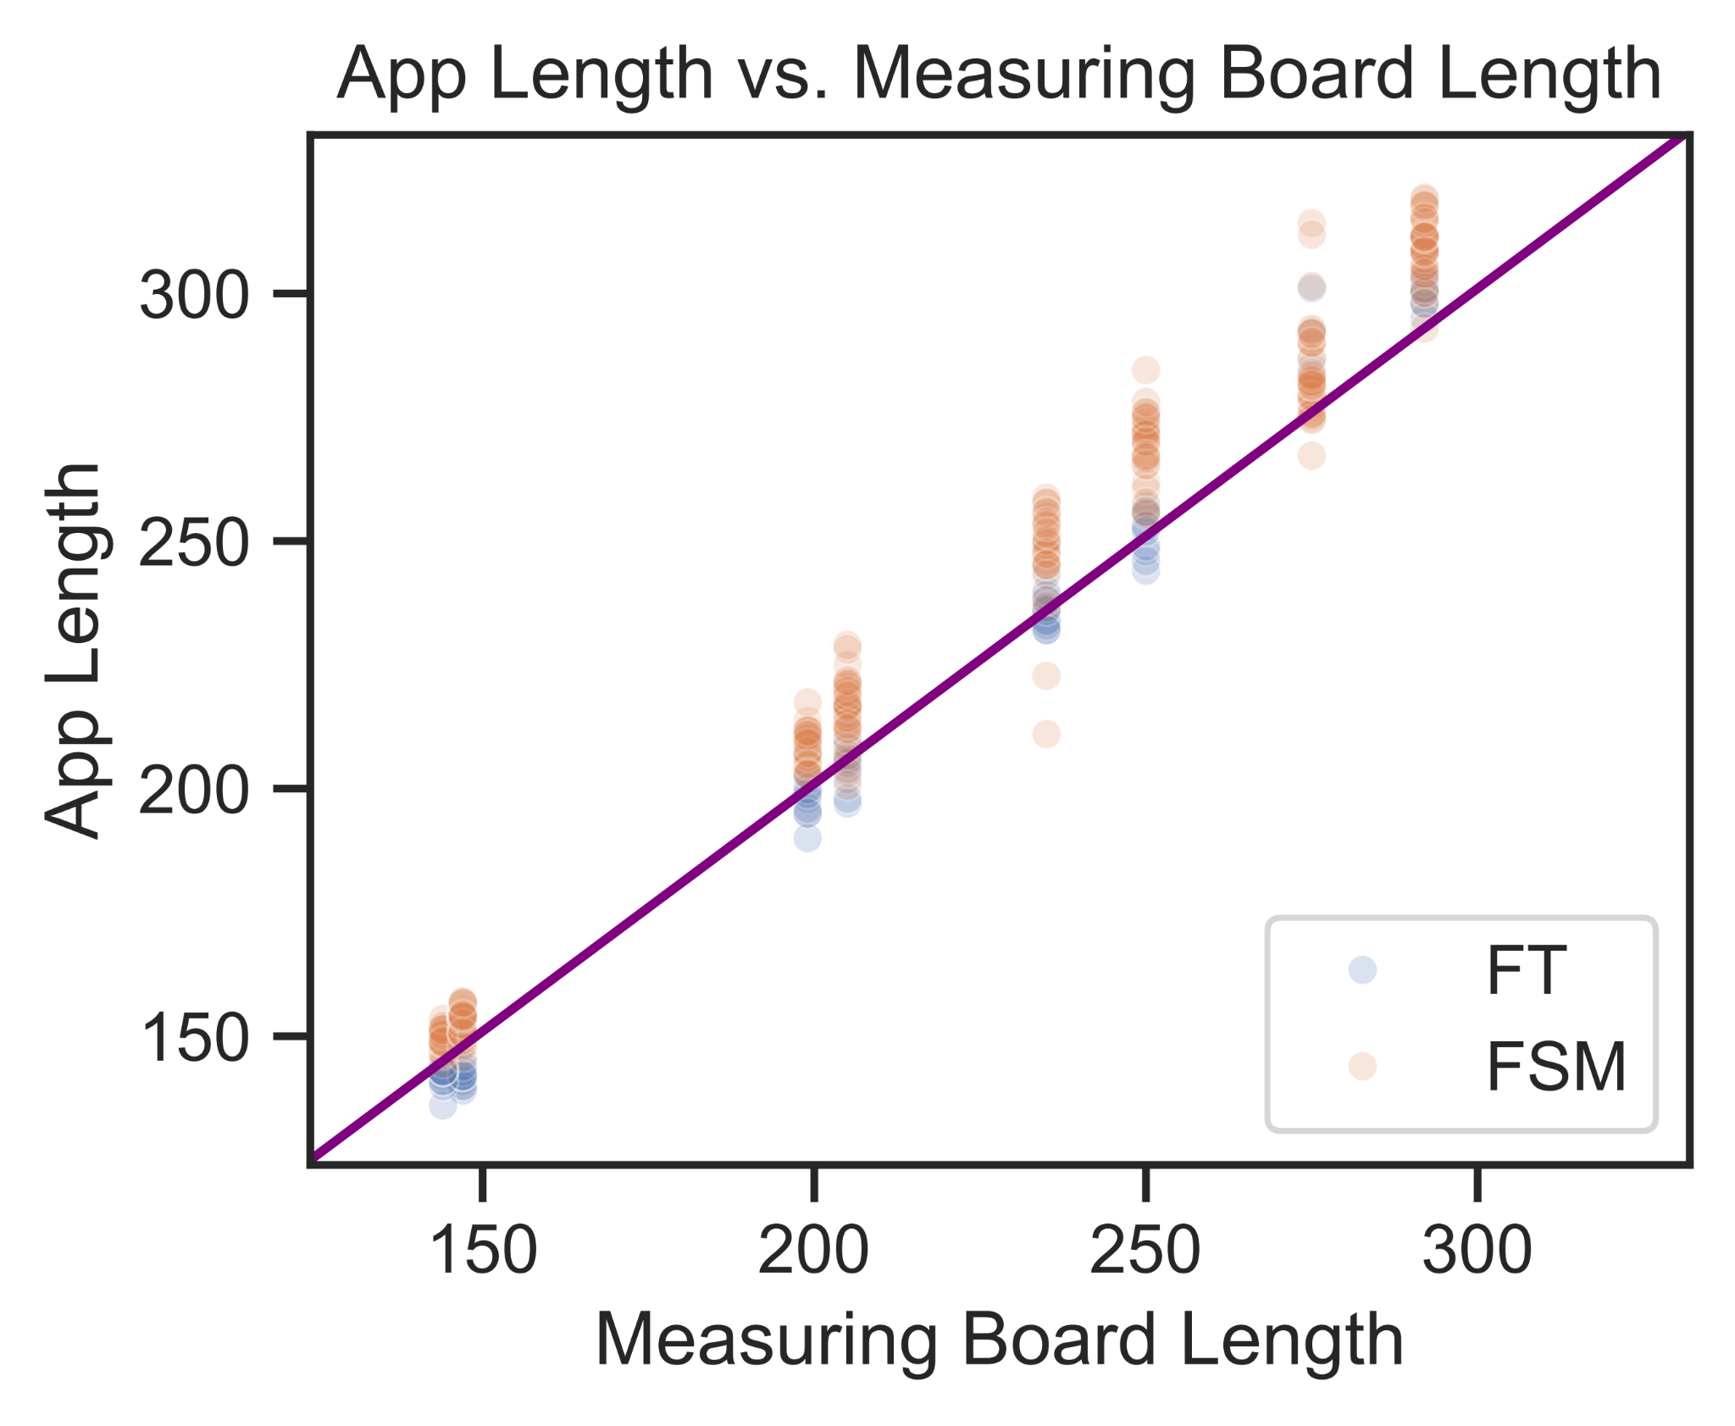
Notes:
Comparison against fish techy against the length board
X axis is the measured length of the fish on the length board
Y axis is the app measured length. Here orange is our app and blue is fishtechy
These were done during a “lab day” with disceased fish

Slide 23
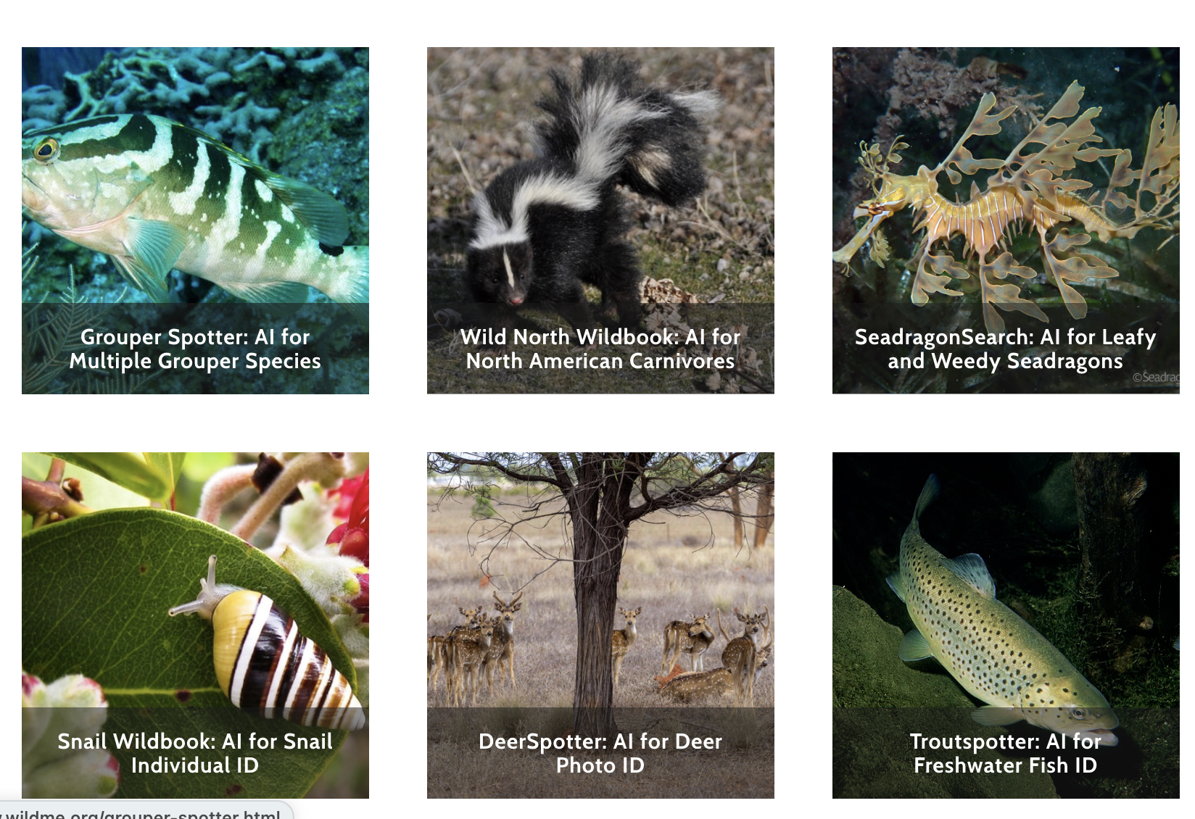
Future Improvements
Data Upload
Additional device support
Species identification
Individual identification
Notes:
Citizen science needs a process to get data off device
expand this to devices that don’t have lidar support
Species identification to help with abundance
Individual identification for target speceis

Slide 24


Paper GitHub
Project Website
Notes:
Left qr code is the github for this paper
Right qr code is our projects website where you can follow us for updates

